Slide 1
Global Wheat Detection
Jeya Seenivasagam, Jade Chia-Chun Hou, Brian Schoenleber

Slide 2
Problem
Measure important plant traits at key moments in their development
Need
Robust and accurate Computer Model that is capable of counting wheat ears from digital images
Techniques
Computer Vision Deep Learning algorithms for Object detection
Previous Work: Faster-RCNN object detection network, encoder-decoder CNN model for semantic segmentation of wheat heads
Challenges
Variability in
observational conditions, genotypic differences, development stages, head orientation
Notes:
Traditionally, sensors are used to observe plants at key moments in their development for agricultural research.
Some important plant traits are still measured manually like counting of wheat ears from digital images.
Overlapping ears, orientation, variations in appearance due to difference in maturity and genotype make this manual counting difficult and error prone.
There is the need for a robust and accurate computer model that is capable of counting wheat ears from digital images.

Slide 3
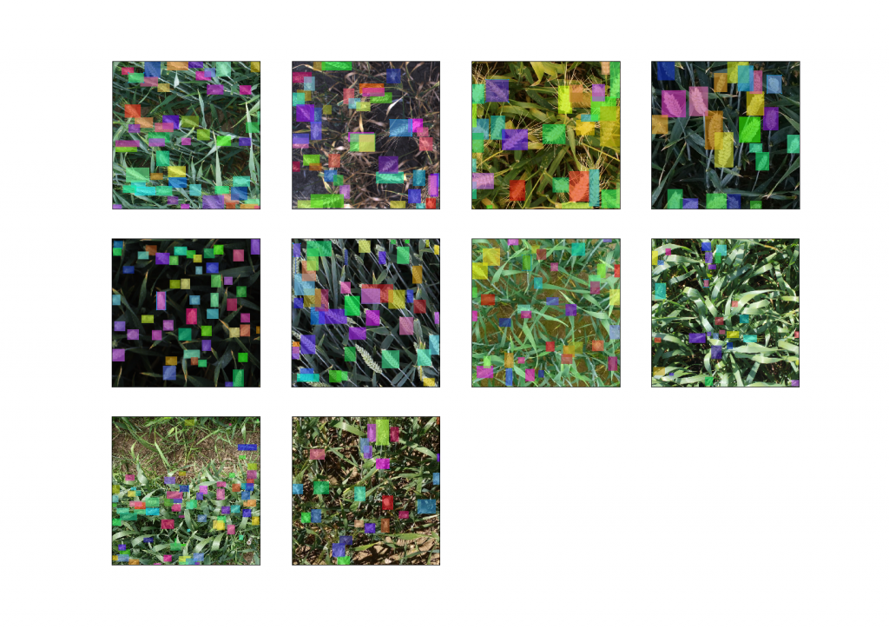
Global Wheat Dataset Images
Notes:
Global Wheat Head detection (GWHD) dataset is a large, diverse and well-labelled dataset
That contains 4,700 high-resolution RGB images and 190,000 labelled wheat heads collected from several countries around the world at different growth stages with a wide range of genotypes.
The data is images of wheat fields, with bounding boxes for each identified wheat head.
All images share a common format of 1024×1024 px with a resolution of 0.1-0.3mm per pixel.

Slide 4
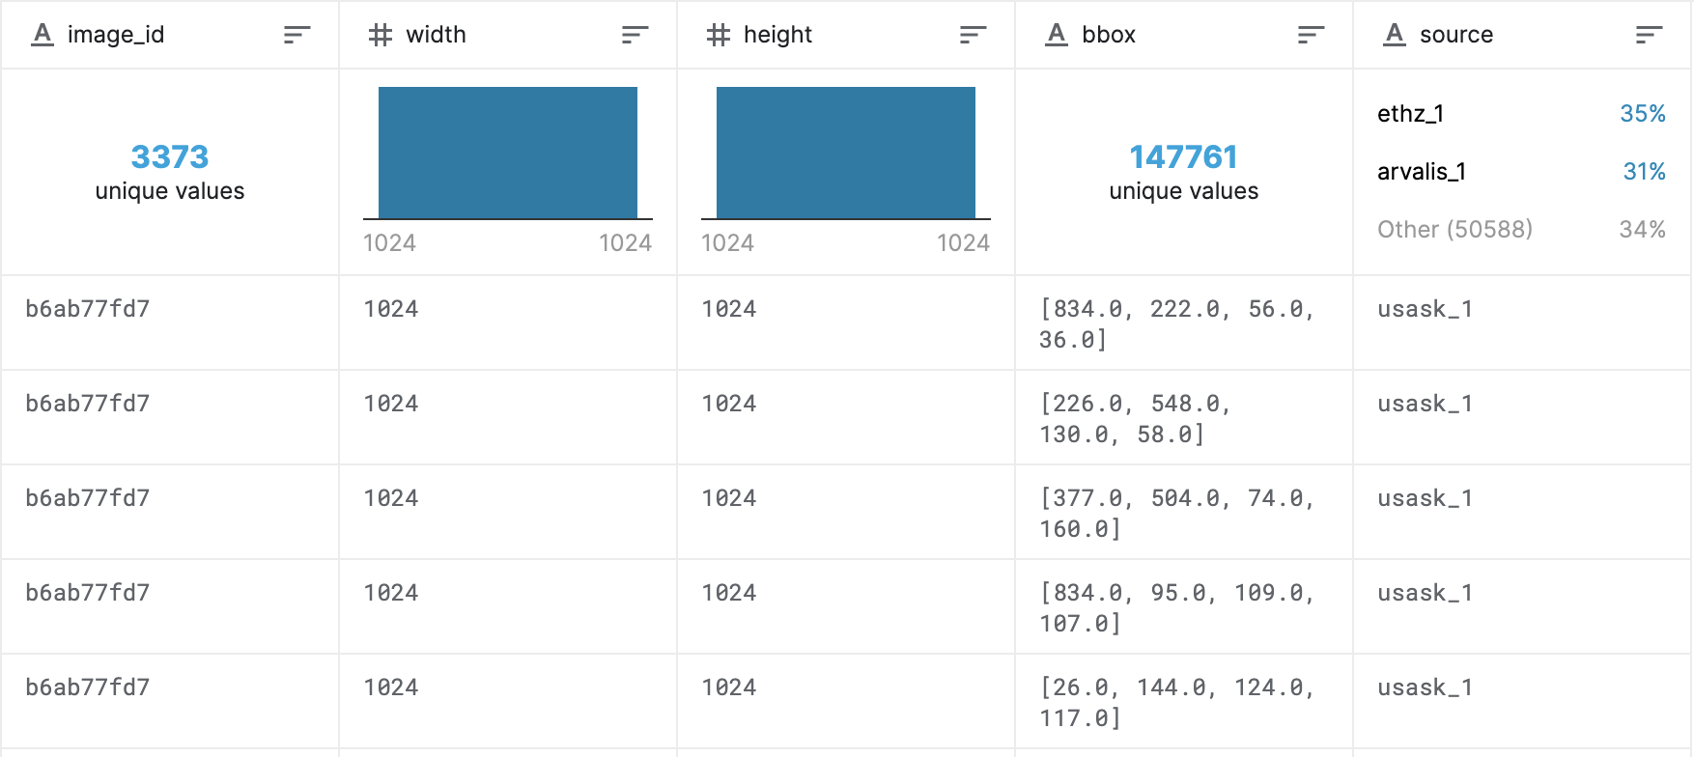
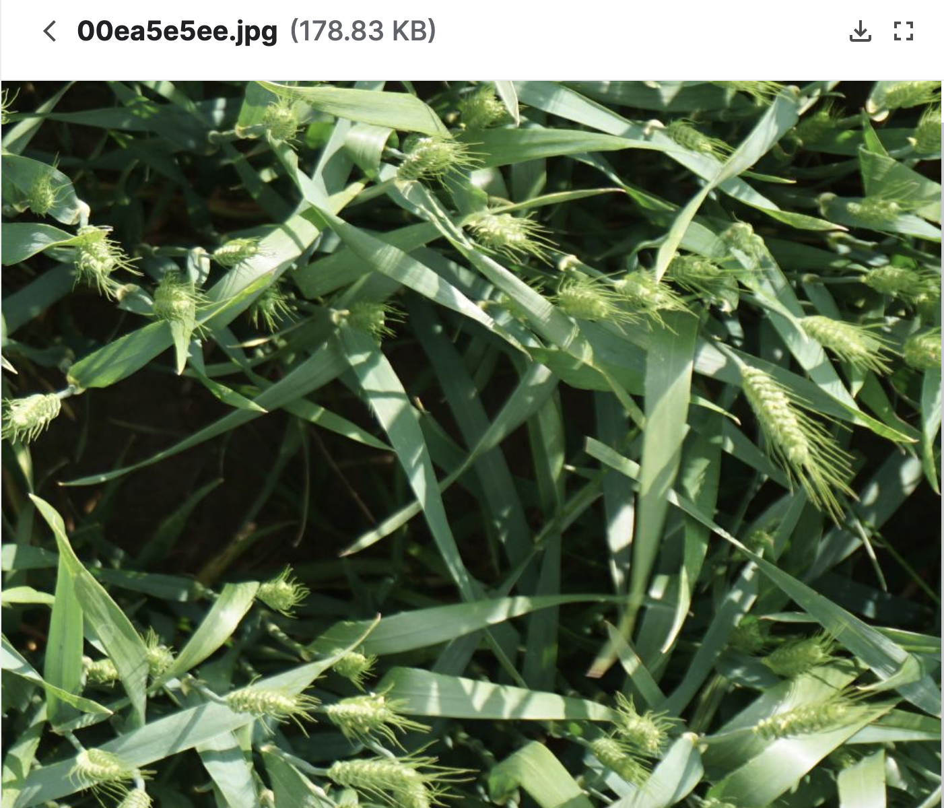
Dataset
Labels in the training set
Example photo in the training set
[xmin, ymin, width, height]
Notes:
The Globel Wheat Head Dataset is led by nine research institutes from seven countries
Wheat head position and size
Number of train images is 3422
Number of test images is 10
3373 training images with wheat heads
49 training images without wheat heads
However, accurate wheat head detection in outdoor field images can be visually challenging. There is often an overlap of dense wheat plants and the wind blur the photographs. Both make it difficult to identify single heads. Additionally, appearances vary due to maturity, color, genotype, and head orientation. Finally, because wheat is grown worldwide, different varieties, planting densities, patterns, and field conditions must be considered. Models developed for wheat phenotyping need to generalize between different growing environments.
Wheat is a staple across the globe, which is why this competition must account for different growing conditions. Models developed for wheat phenotyping need to be able to generalize between environments. If successful, researchers can accurately estimate the density and size of wheat heads in different varieties. With improved detection farmers can better assess their crops, ultimately bringing cereal, toast, and other favorite dishes to your table.

Slide 5
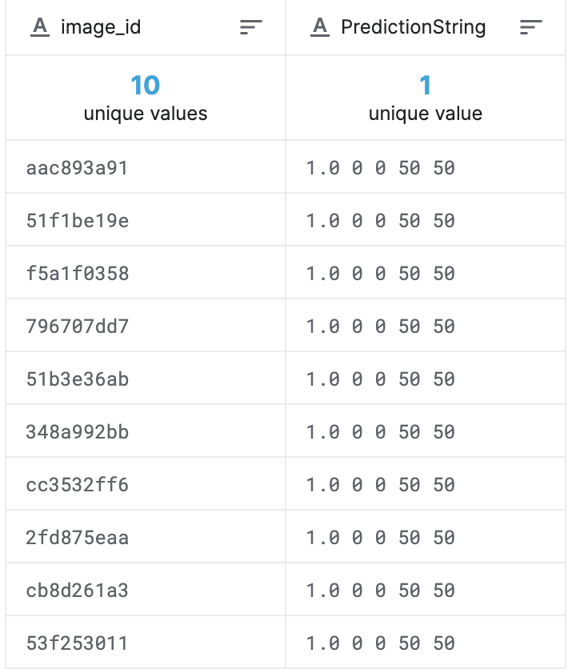
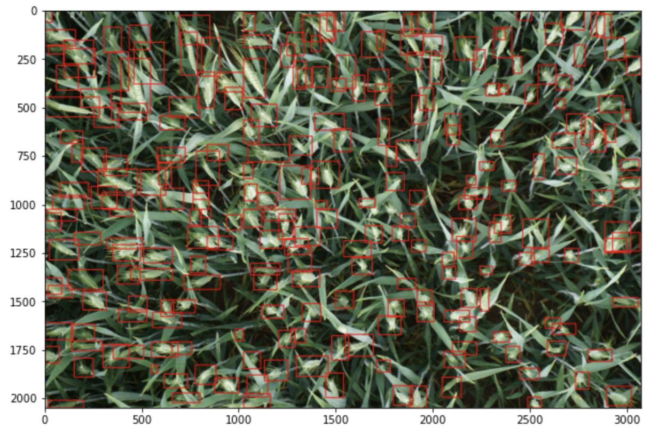
Prediction
Prediction of each wheat head position
Prediction of each wheat head
[confidance, xmin, ymin, width, height]
Notes:
You are attempting to predict bounding boxes around each wheat head in images that have them. If there are no wheat heads, you must predict no bounding boxes.
This could help plant scientists to study wheat fields worldwide, including estimate the density and the size of different varieties. Also, farmers can use this data to access health and maturity when making management decisions in their fields.
We get 3422 training images for us to train, but only 10 public test images to validate. So this would be challenging for us to validate our model.
Photo reference: https://www.kaggle.com/trungthanhnguyen0502/jigsaw-puzzle-restore-original-full-size-image

Slide 6
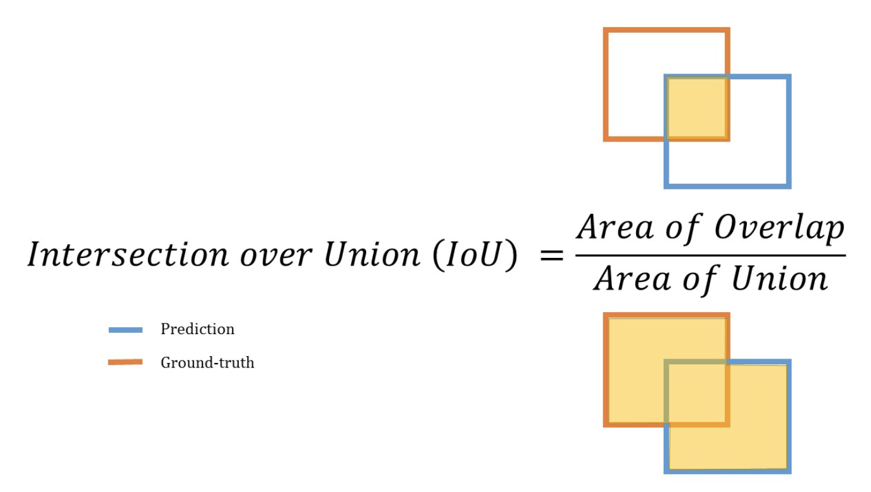
Evaluation

Slide 7
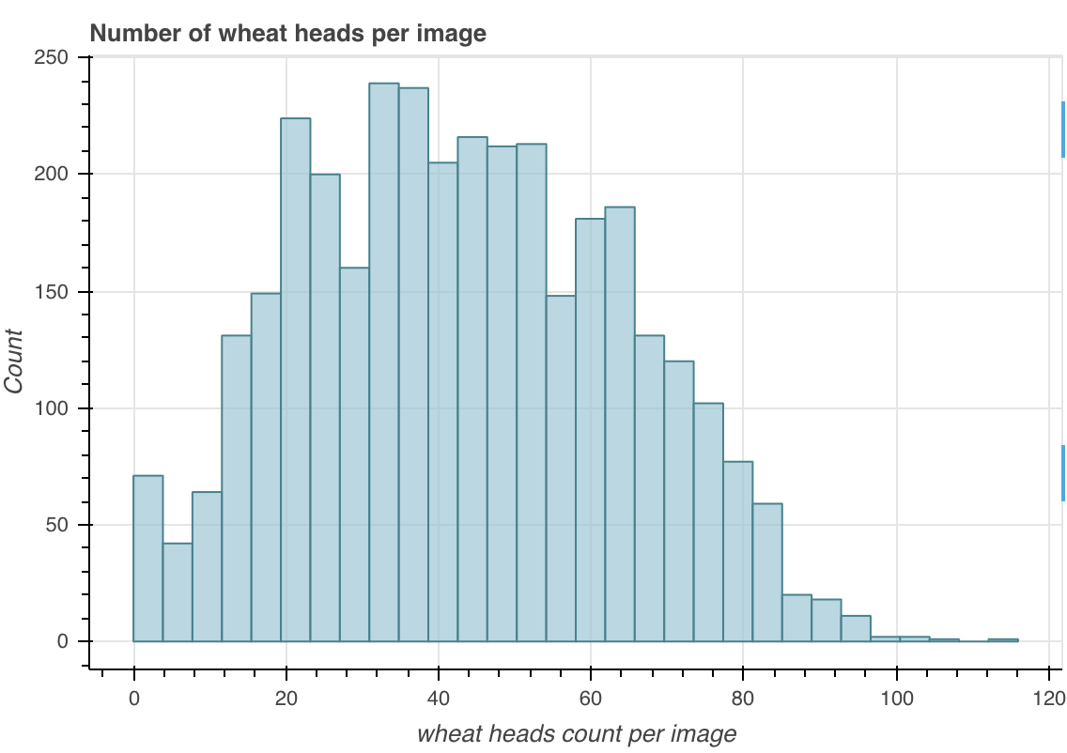
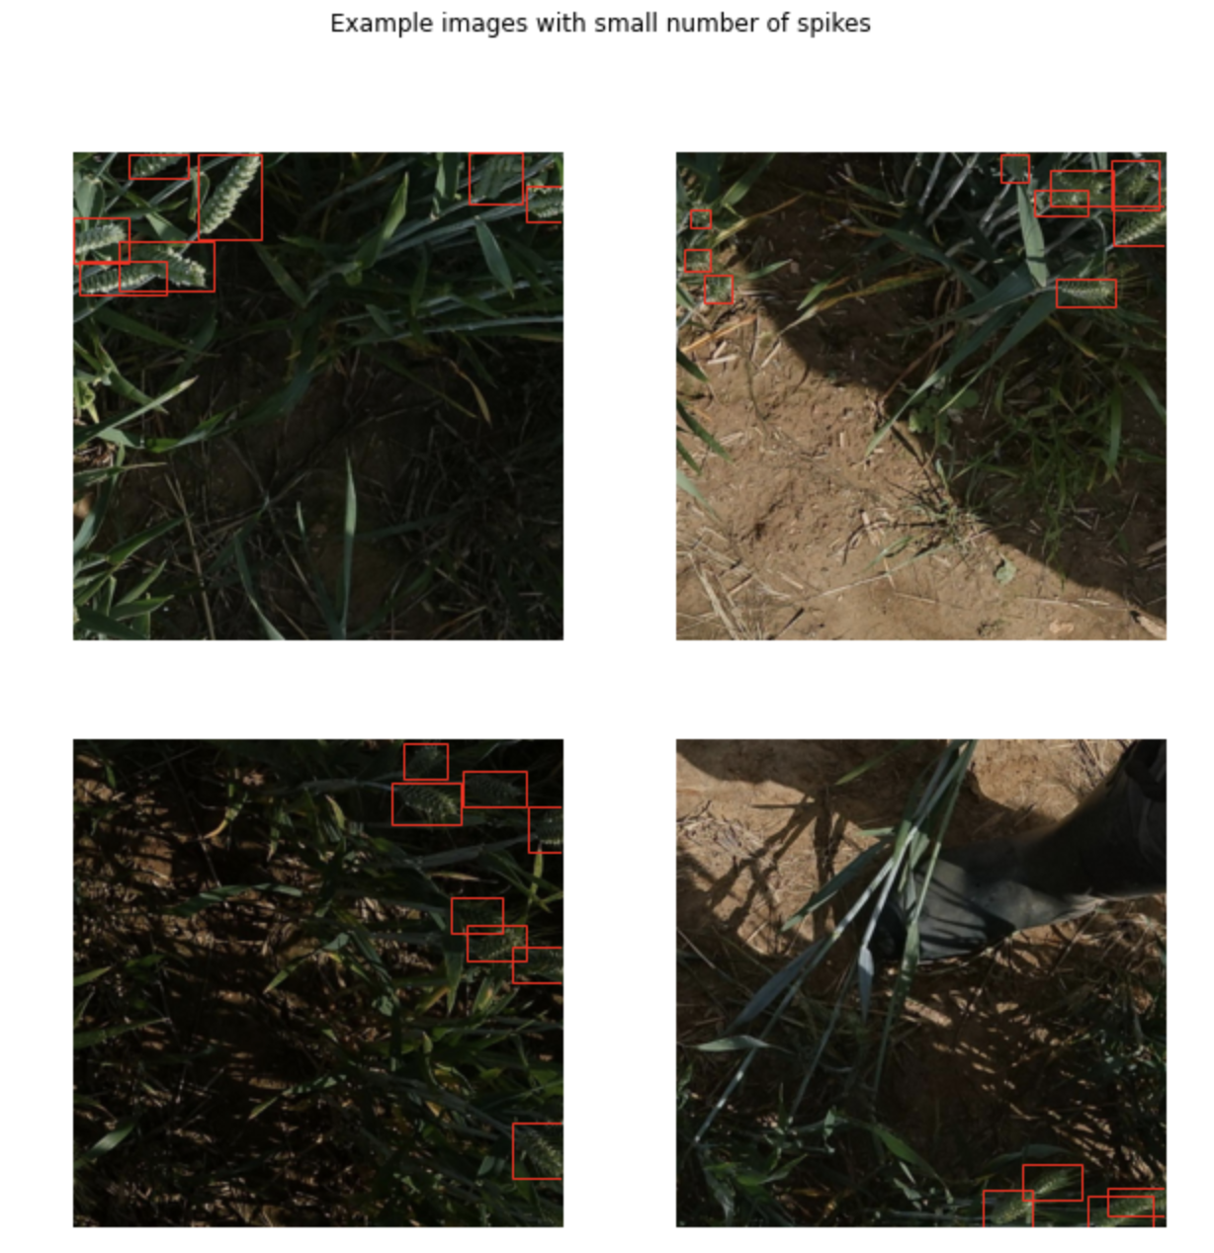
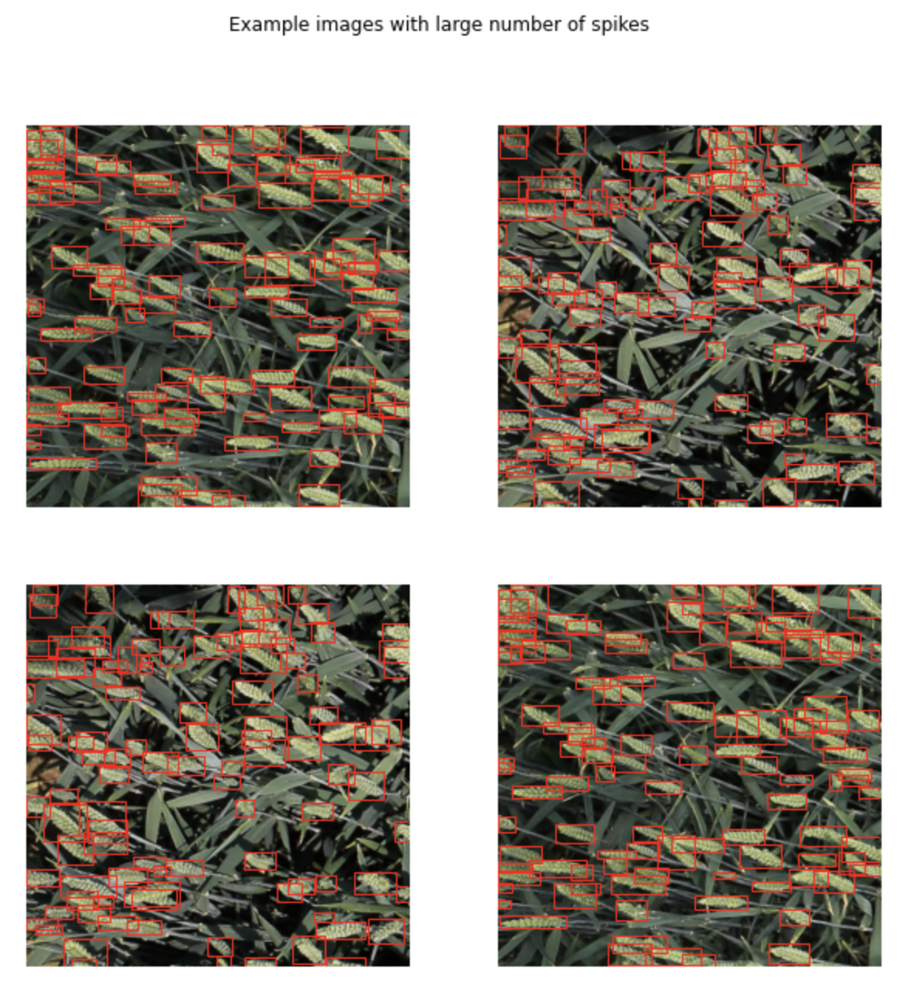
EDA - Wheat head counts
Notes:
Images are taken at different zoom levels. Crop and resize data augmentations to be used for model training.
Images are taken at various lighting conditions. Special filters should be used to address that.
Bounding boxes are messy!
Giant bounding boxes should be filtered out by area and removed before model training.
Micro bounding boxes. These can stay. They won't have much effect on the IOU metric.
Some spikes are not surrounded by a bounding box (missing bounding boxes).

Slide 8
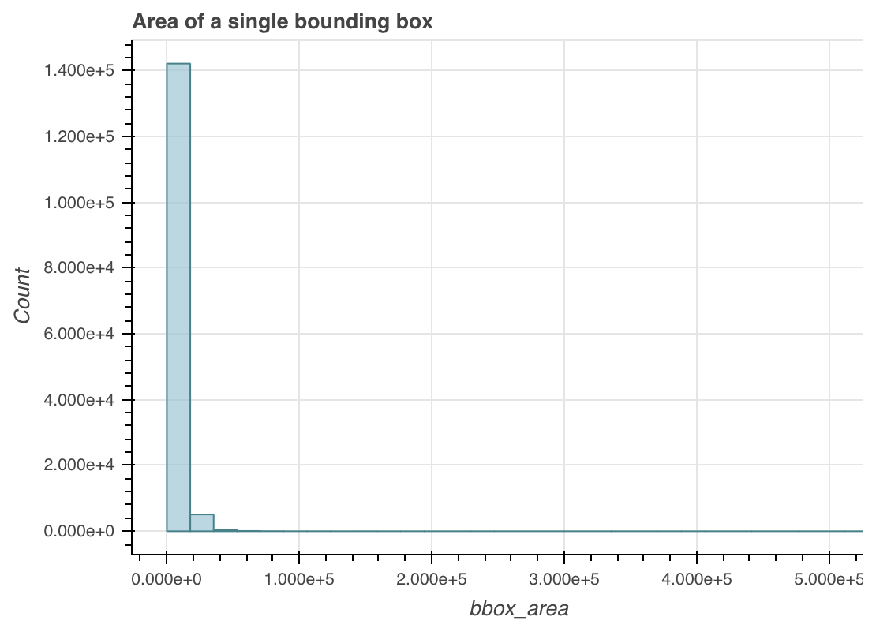
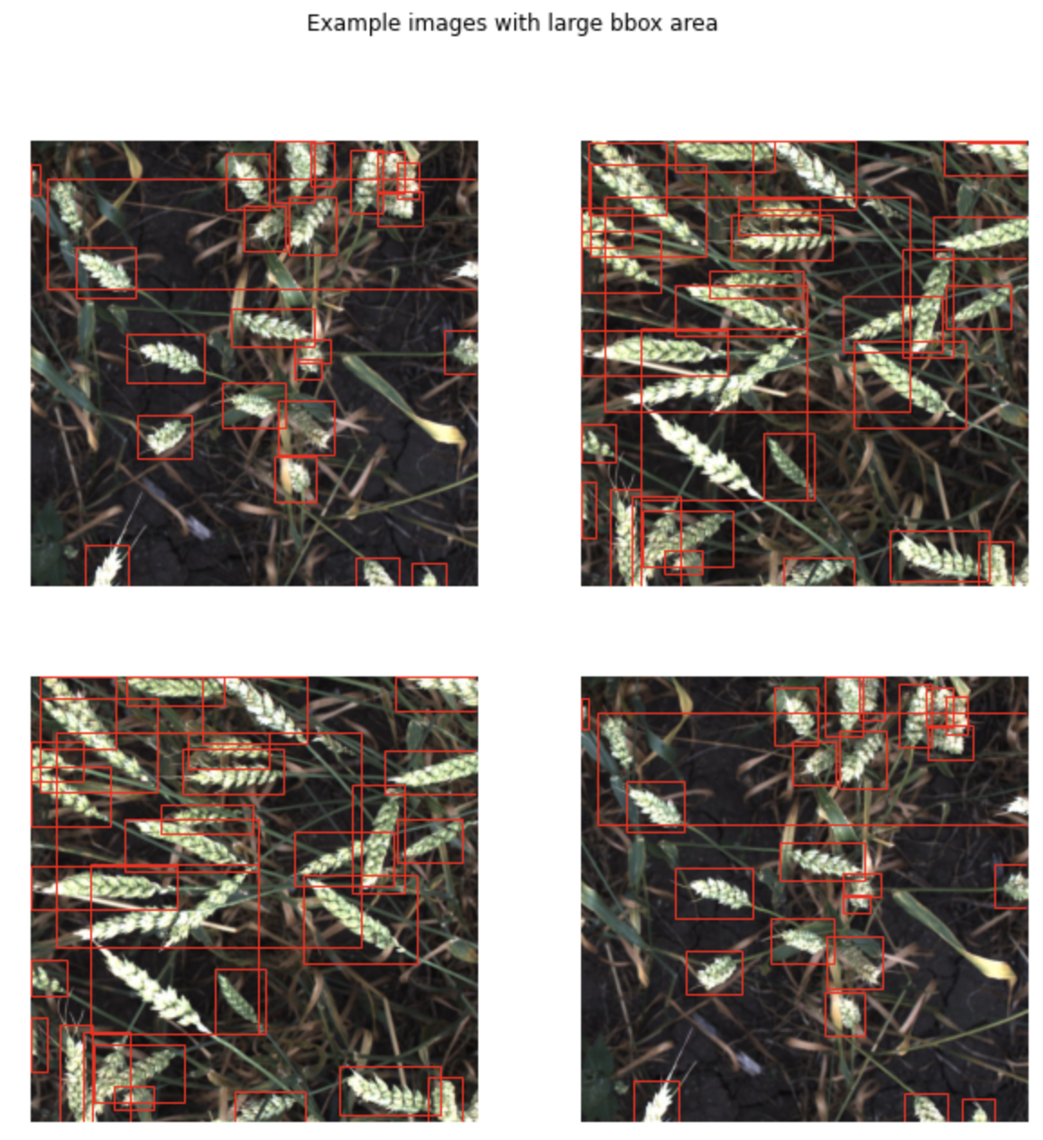
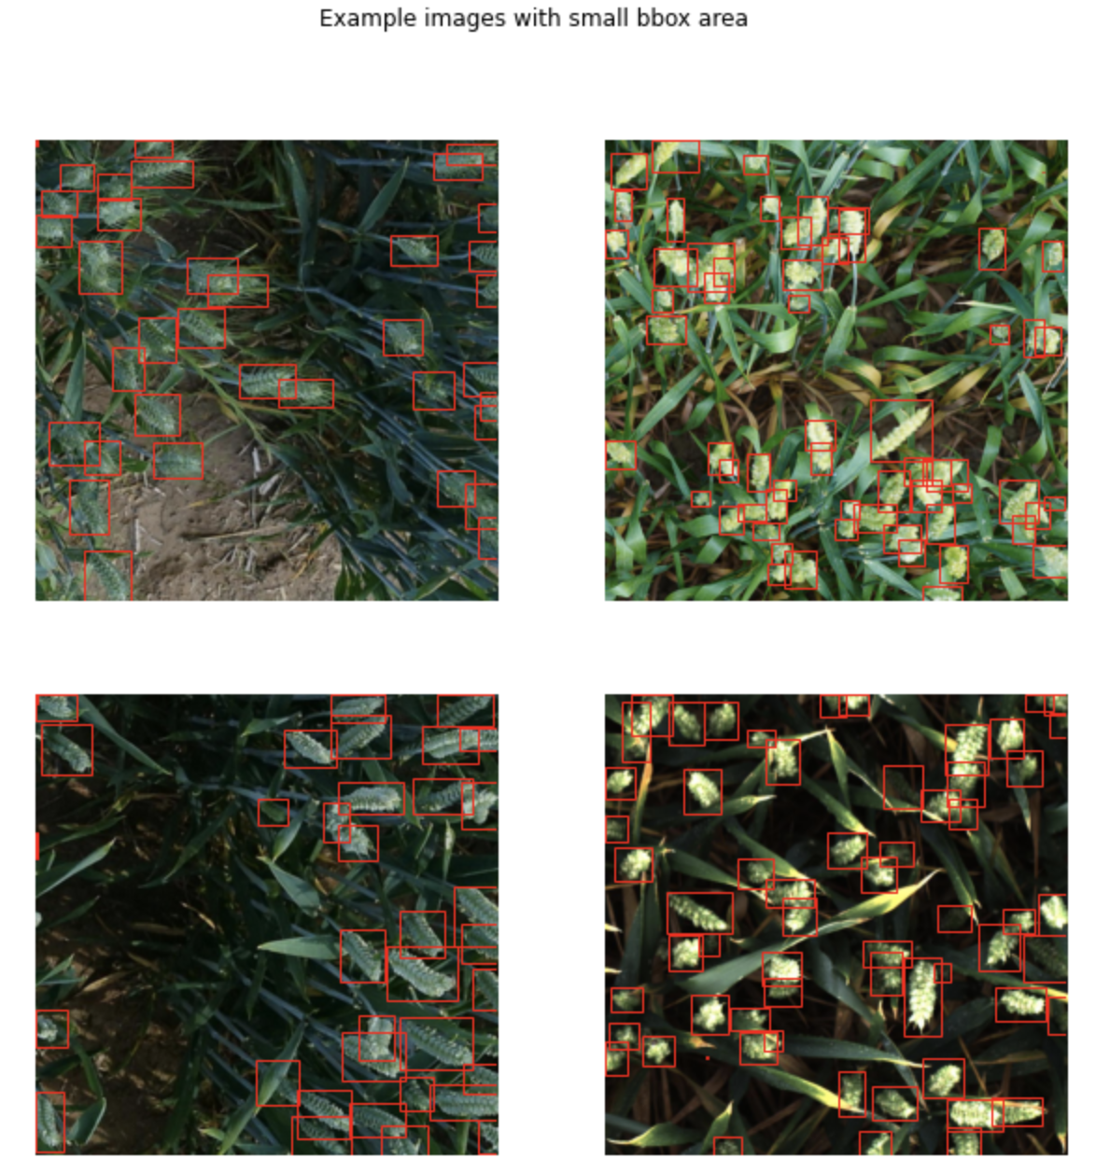
EDA - Wheat head area per spike
Notes:
Images are taken at different zoom levels. Crop and resize data augmentations to be used for model training.
Images are taken at various lighting conditions. Special filters should be used to address that.
Bounding boxes are messy!
Giant bounding boxes should be filtered out by area and removed before model training.
Micro bounding boxes. These can stay. They won't have much effect on the IOU metric.
Some spikes are not surrounded by a bounding box (missing bounding boxes).

Slide 9
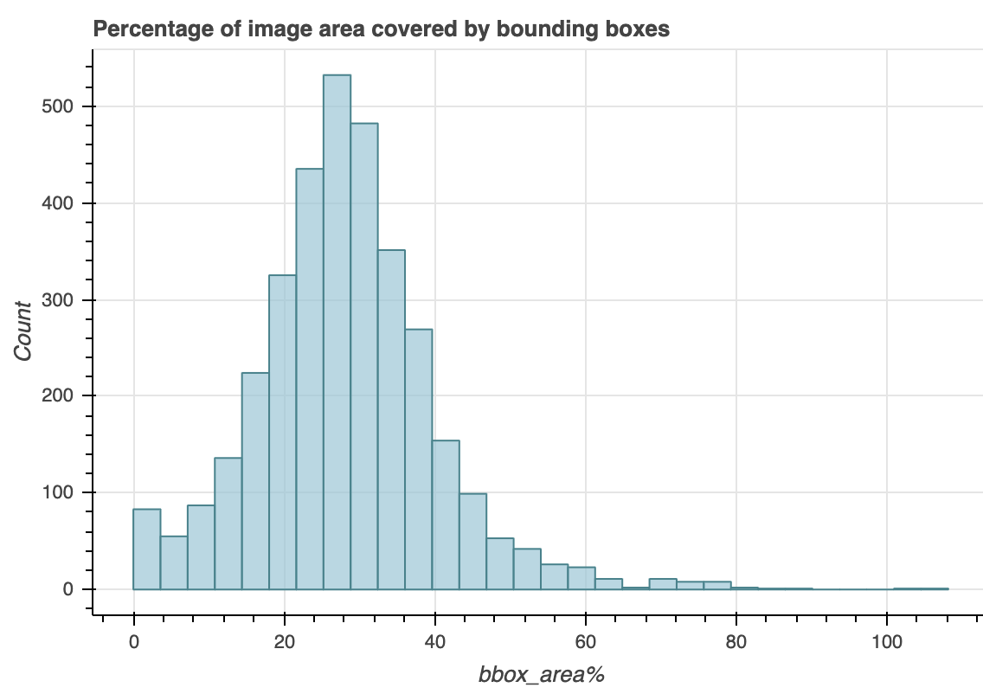
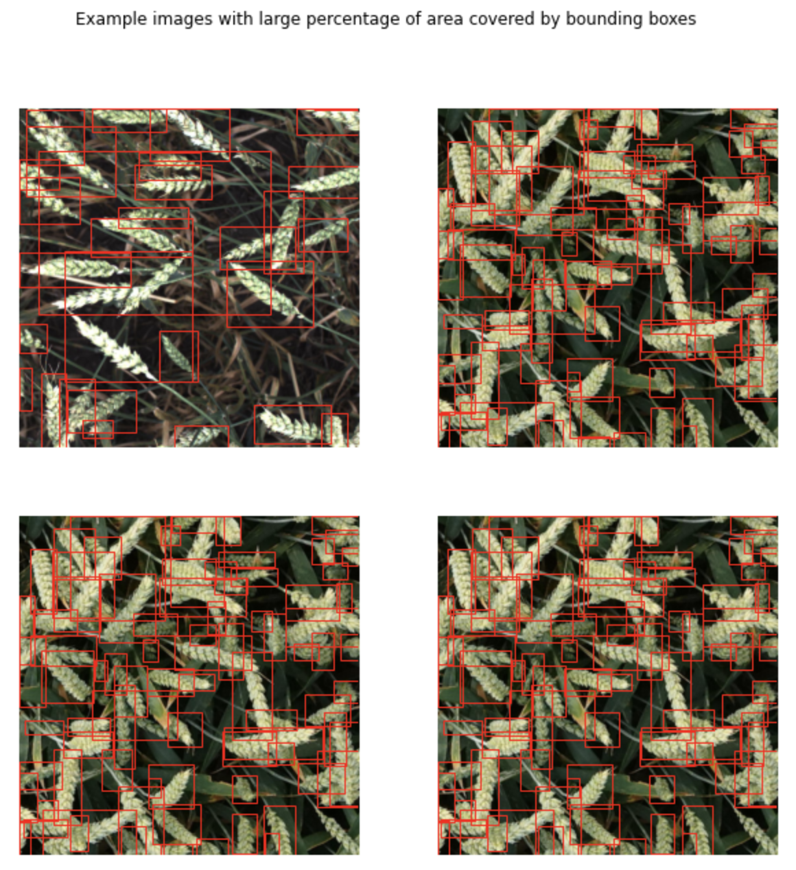
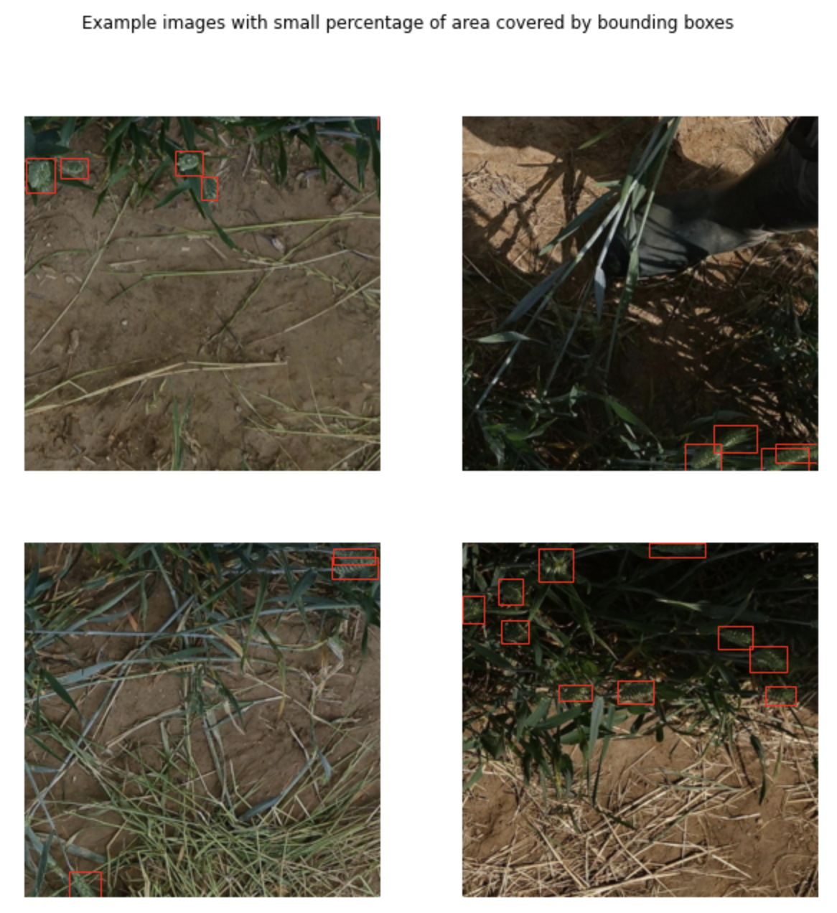
EDA - Bounding box area per image

Slide 10

Object Detection Model & Library
Faster R-CNN model with a ResNet-50-FPN backbone - pre-trained on COCO train2017
torchvision.models.detection.fasterrcnn_resnet50_fpn(pretrained=True)
Hyper-parameters
Epoch : 1, 10, 20, 60
Learning Rate: 0.001, 0.005
Momentum: 0.8, 0.9
Weight Decay: 0.0005, 0.005
Notes:
much faster than its predecessors
real-time object detection

Slide 11


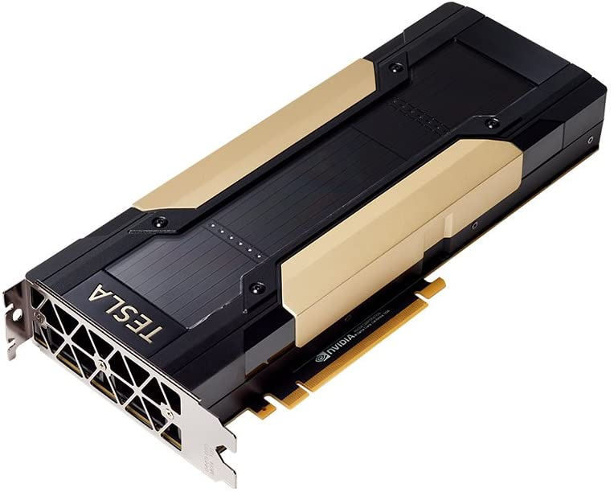
V100 Runtime Metrics

Slide 12
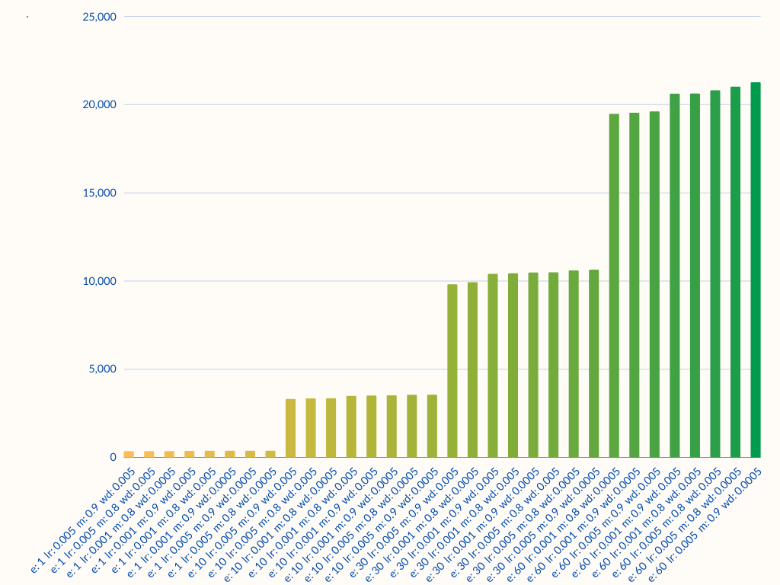
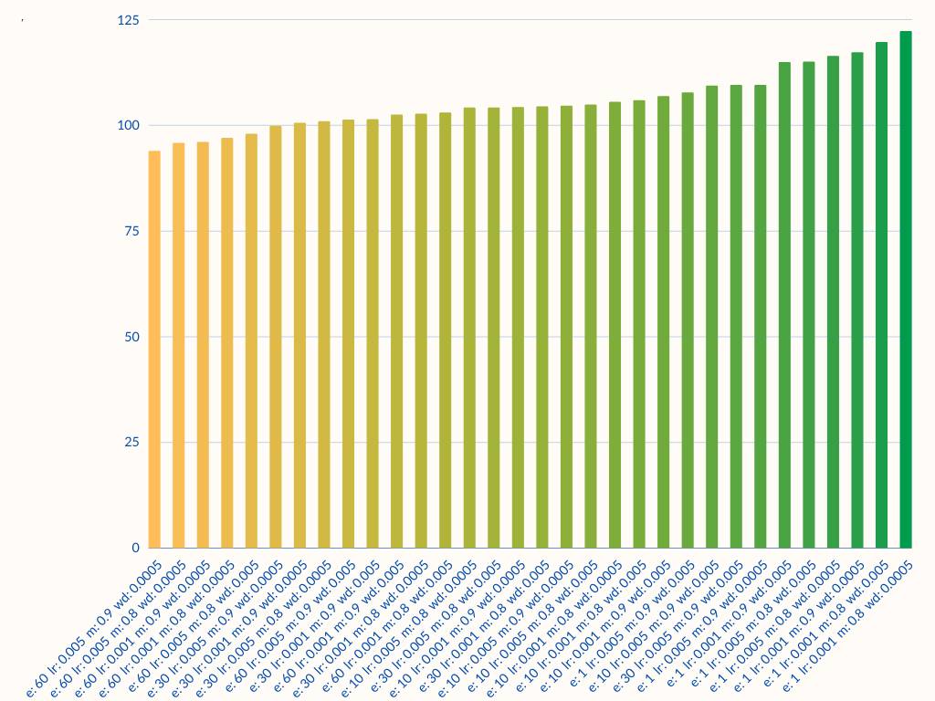
Train time (seconds)
Test time (seconds)

Slide 13
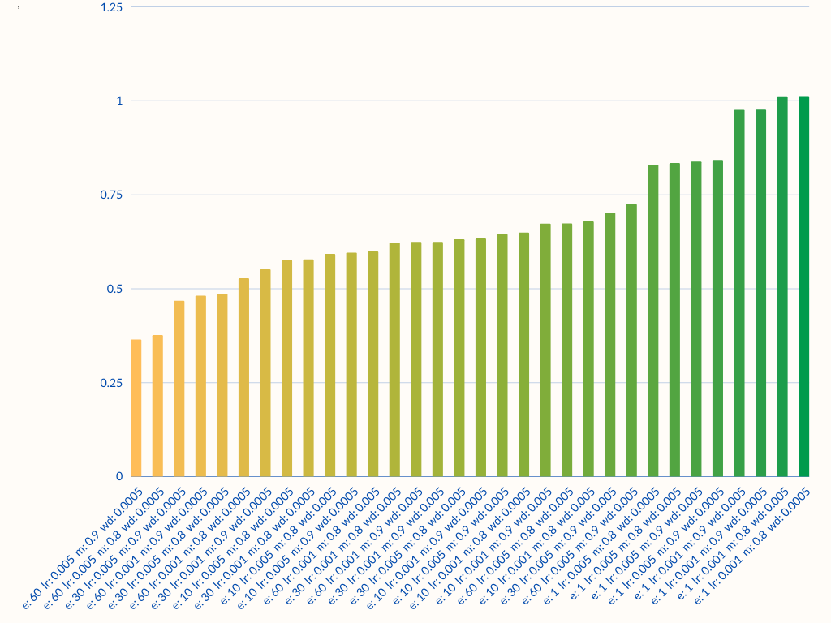
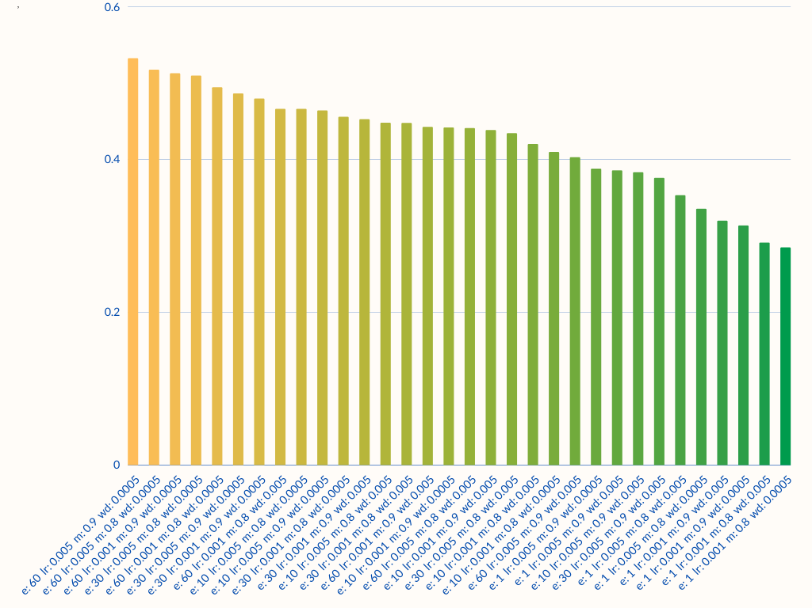
Train loss
Test IOU

Slide 14
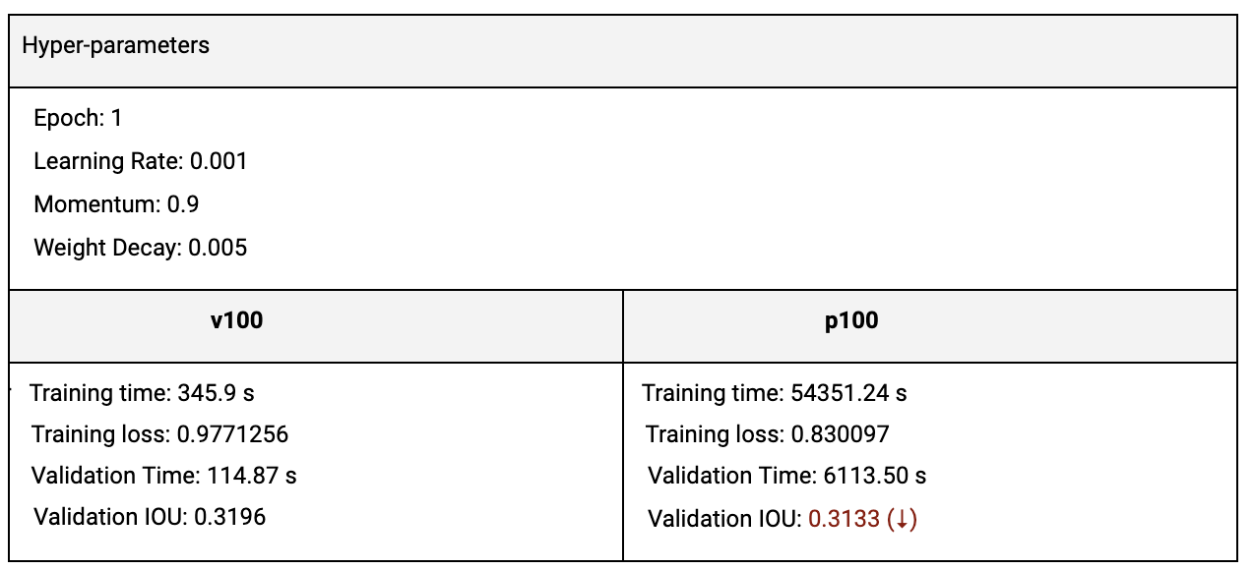
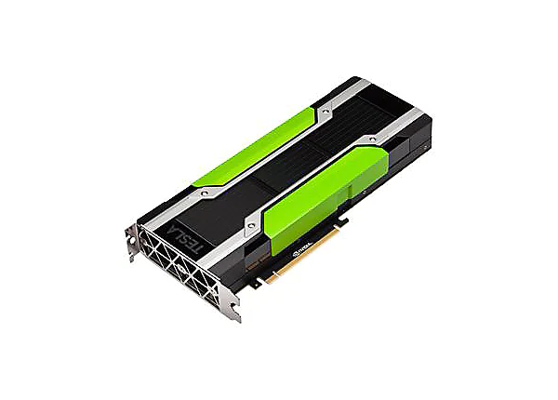

V100 Runtime Metrics

Slide 15

Data Augmentation
Using Albumentation

Slide 16
Augmentation functions
Any one of
[
Light (RandomBrightnessContrast,RandomGamma),
Medium (HueSaturationValue),
Shade (ChannelShuffle)
]
Any one of
[
RandomRain,
RandomSnow,
RandomSunFlare,
RandomFog
]
+

Slide 17
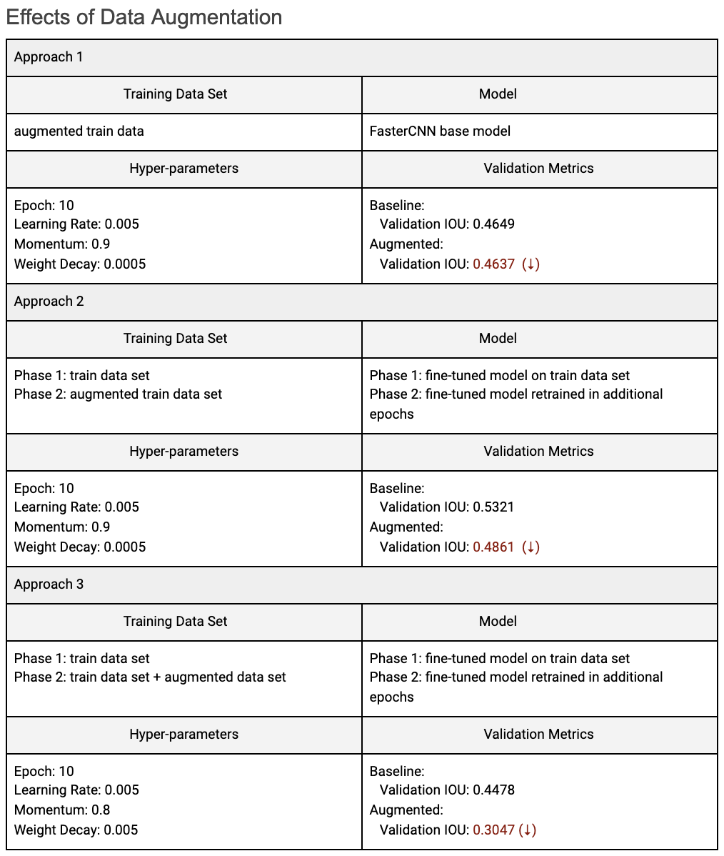

Slide 18

Compute Environments
X

Slide 19
Thank you

